Slide 1
Predicting Stock Prices Using Sentiment Analysis

Slide 2
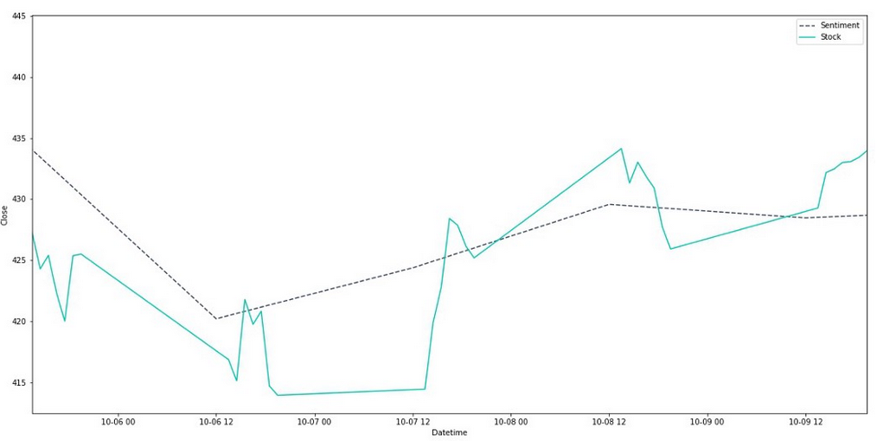
Our Goal
We want to find if there is a correlation between sentiment and stock price at specific companies.
Ideally, we want to know if we can predict changes in stock prices with sentiment analysis.
If there is a correlation, can we figure out how the time lapse from sentiment change to stock price change?
We also want to see if Cryptocurrency can be predicted with similar sentiment analysis.

Slide 3
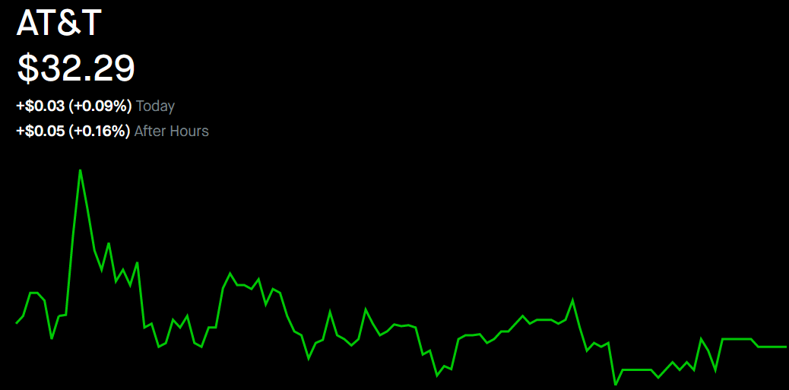
Methodology
We gathered tweets using the Twitter API in order to find the sentiment over 30 minute time periods.
We collected the stock prices of the stocks in question on those same 30 minute intervals for the length that the stock market was opened (9:30am-4pm).
We then grouped all tweets after-hours and measured average sentiment to bridge the gap until opening the next day.
For cryptos, we did not have this problem
since they are traded 24/7

Slide 4

Companies We Are Interested In
Stable companies like Charles Schwab and AT&T which shouldn’t have a ton of fluctuation in sentiment and give us a baseline.
Technology companies like Facebook and Tesla, who have big followings and are a little more of a wild card in terms of sentiment as well as stock prices.
Cryptocurrencies with big followings like Etherium and Dogecoin, which have lots of people talking and are highly volatile. Will sentiment be able to predict the high swings? And will the controversies tied to them be shown in the stock prices?

Slide 5
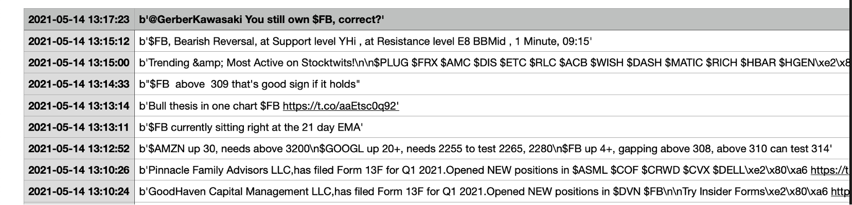
Facebook - Gathering sentiment
We chose Facebook because the company reported revenue of 26.17 billion for Q1, which was up by 48% compared with a year prior.
We would like to see if the trend is continuing in 2nd quarter while comparing it to the rise and fall of sentiment.
We were able to gather tweets for a certain time.

Slide 6
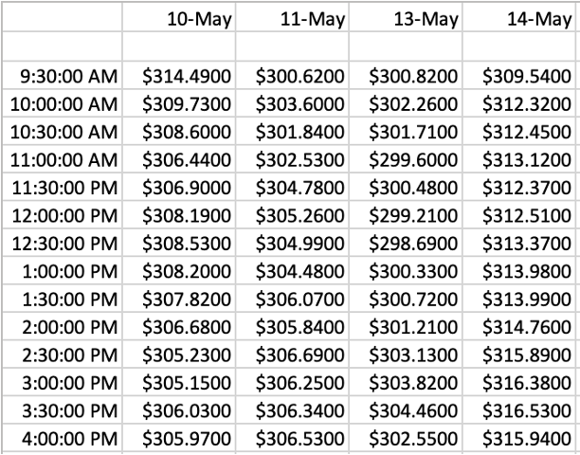
Facebook - Gathering sentiment
We were able to gather stock prices between a certain time frame by looking at the Dow Jones Industrial Average Advanced Charting. Once gathered for Facebook we organized the data on an excel file.

Slide 7

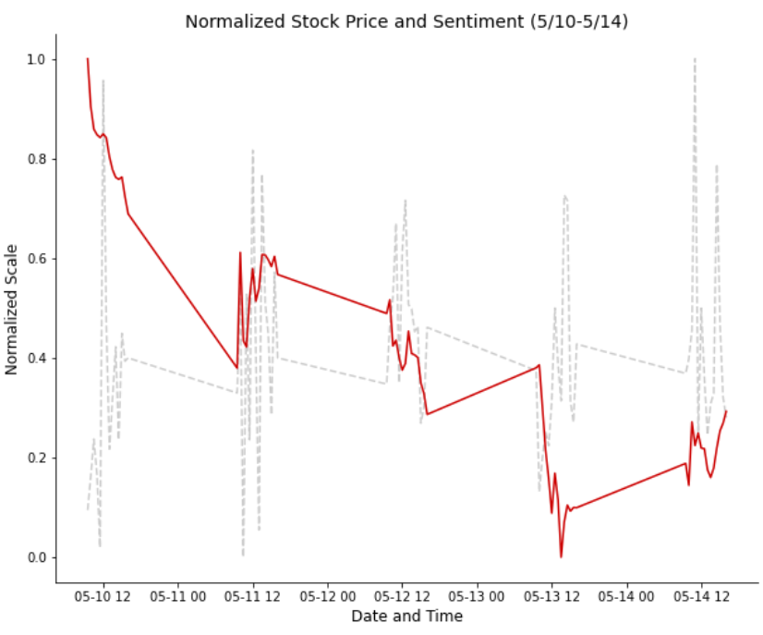
Tesla
In order to compare stock price which is on a scale of $562.04-$659.30, with sentiment which is on a scale of -1 - 1, we can normalize the data. It ruins the y-axis scale but allows us to compare.
It is still hard to really decipher any useful information. We will exploring using rolling averages and other noise reducing techniques to learn more.
With reducing noise and using another week or two of data, we should get a clearer answer soon.
Also if we can reduce the 4-9:30 gaps, it would help a lot.

Slide 8
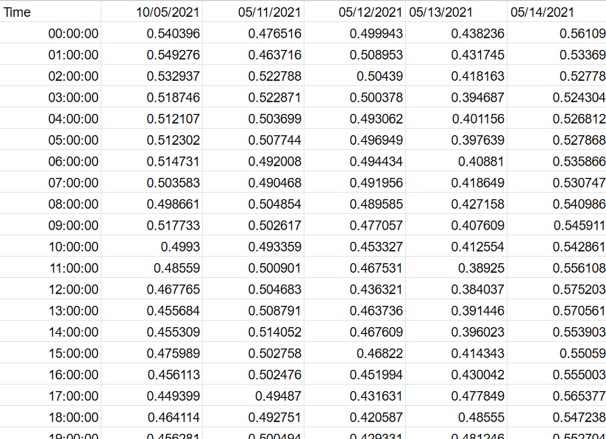
Dogecoin
So in order to create a CSV of tweets about doge, you need to change the search word from “$TSLA” to “Doge”
I did not do that. The code has been running for over 24 hours now. Sorry :(
Here are things I have currently for Doge:

Slide 9

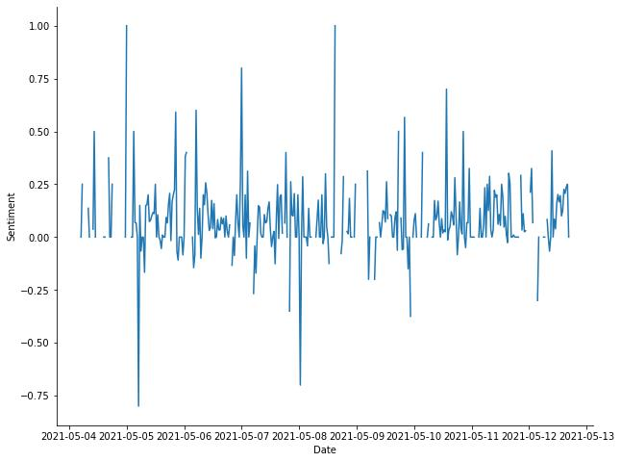
AT&T
AT&T gives us a lot of data points when
collecting tweets and running sentiment
analysis. Just looking at the data we see
a lot of highs and lows in terms of sentiment
which runs contrary to our initial assessment
that the stable companies would show little
variation in sentiment.

Slide 10

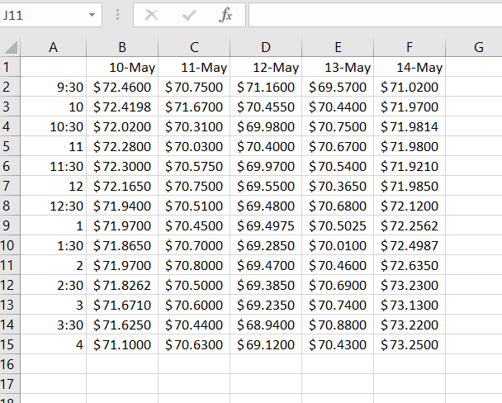
Charles Schwab
Charles Schwab’s stock price has recently
hit a 52-week high on the close of the stock
market last Friday, May 14th. This should
show some interesting sentiment in the
upcoming week. Here you can see we have
all of the stock prices we need to compare
to our sentiment data except for after-hours

Slide 11
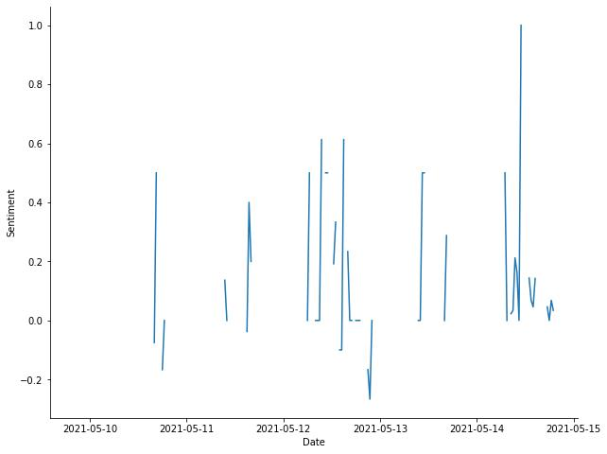
Charles Schwab
Just looking at the results of the sentiment
analysis for Schwab, we can see that the
majority of tweets have been positive which
runs in line with the stock price being at an all-
time high.

Slide 12
What’s to come?
Clearly we aren’t where we want to be in terms of project completion, but we are acquiring data to use and getting closer to being able to find what we need.
We still need to:
Complete our CSVs of tweets, along with running them another time to have more than one week of data. If we run again, we will have plenty to run.
Keep collecting stock prices and crypto prices
Complete our dataframes that allow us to graph sentiment and stock prices together
Find a way to reduce noise in both of these line charts and see if there are patterns
Maybe off-set the times to see if there is a lag between sentiment and stock price
We have a lot to do, but being able to graph Tesla should be easy to adapt for the others

